Slide 1
Personal Email Financial Analysis
Data Science Study Case
Angel Berta Desi Suryanti Puji Resmiati

Slide 2




The problem

Slide 3
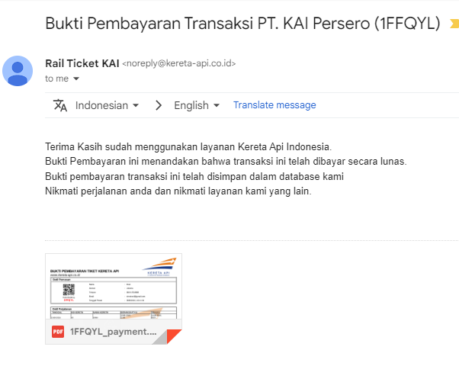
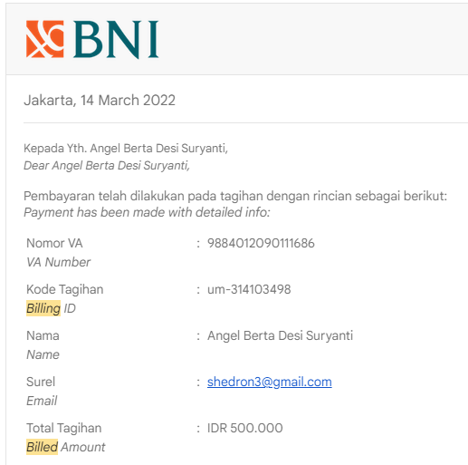
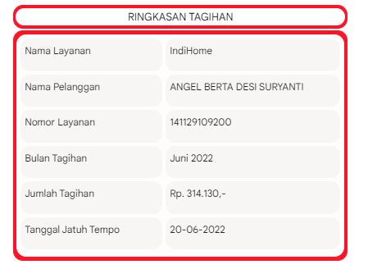
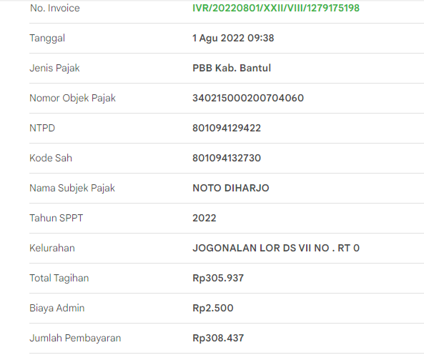
The problem

Slide 4
The problem
Problem statement
There are unorganized email in our GMAIL inbox
Those emails are uncategorized and coming from so many application (e-commerce, entertainment, bank, membership account)
It is hard to analyse the email related to billing and other expenses email

Slide 5
Challenges deep-dive
Challenge 1
Challenge 2
Challenge 3
Data Collection
Found non standard email will give homework to the project
Data Extraction
Body email extraction needs extra care code to process it, and it’s not easy to do it
Data format
Cleansing the data to the standard format is one of thing to do

Slide 6
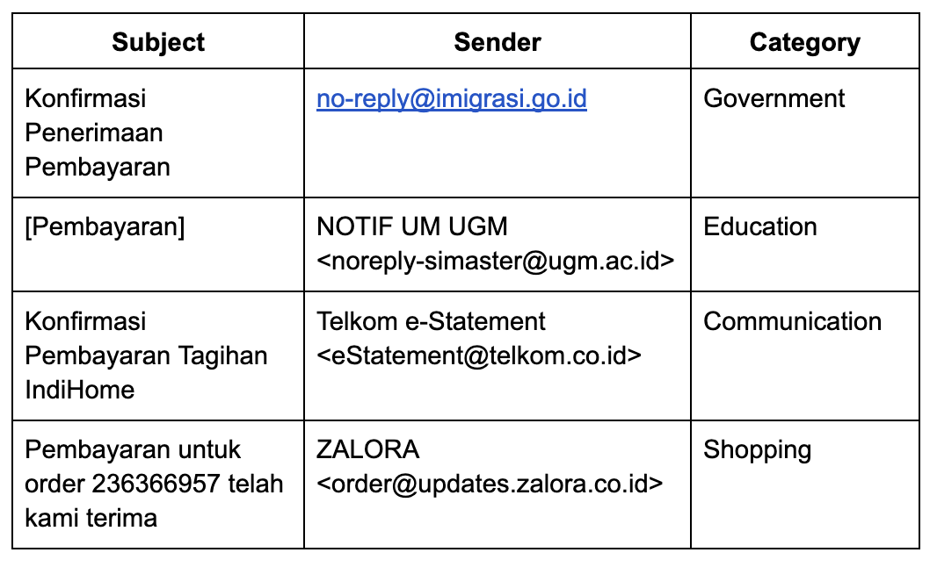
Analysis
Qualitative Analysis

Slide 7
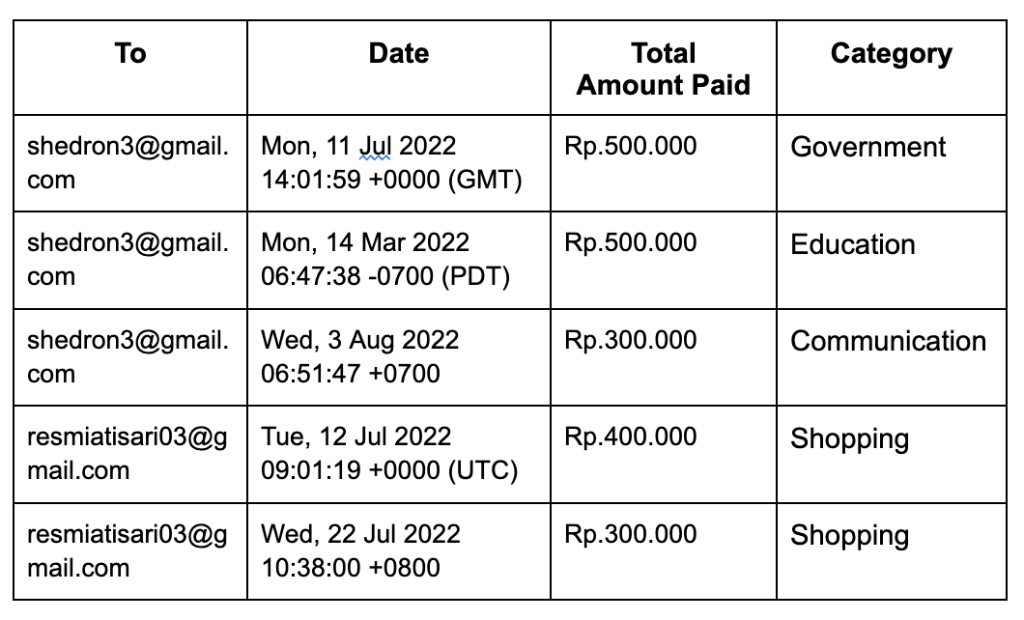
Analysis
Quantitative Analysis

Slide 8
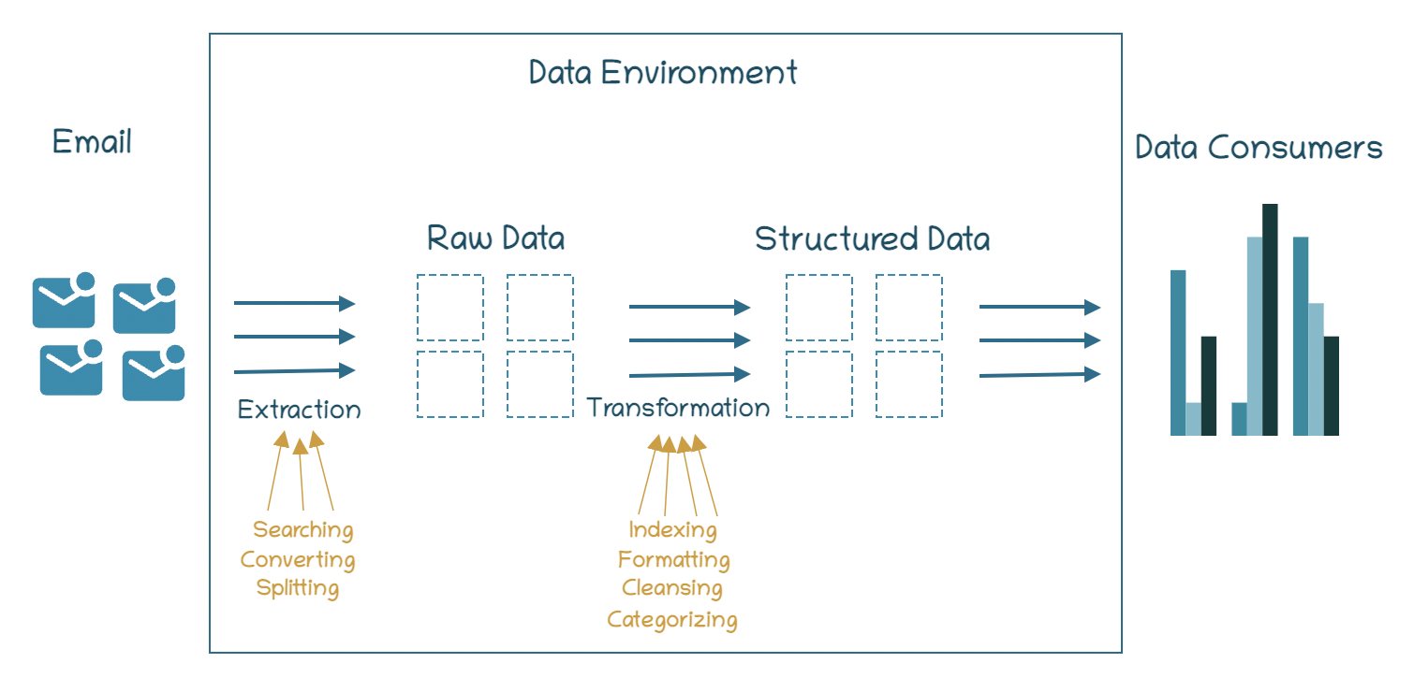
System Design:
Python
Gmail API
BeautifulSoup
Report Design:
Graph
Database Design: Mysql

Slide 9
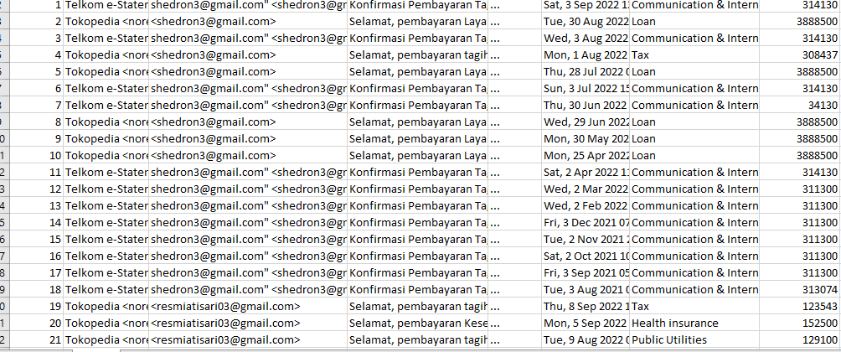
Current Result Design

Slide 10
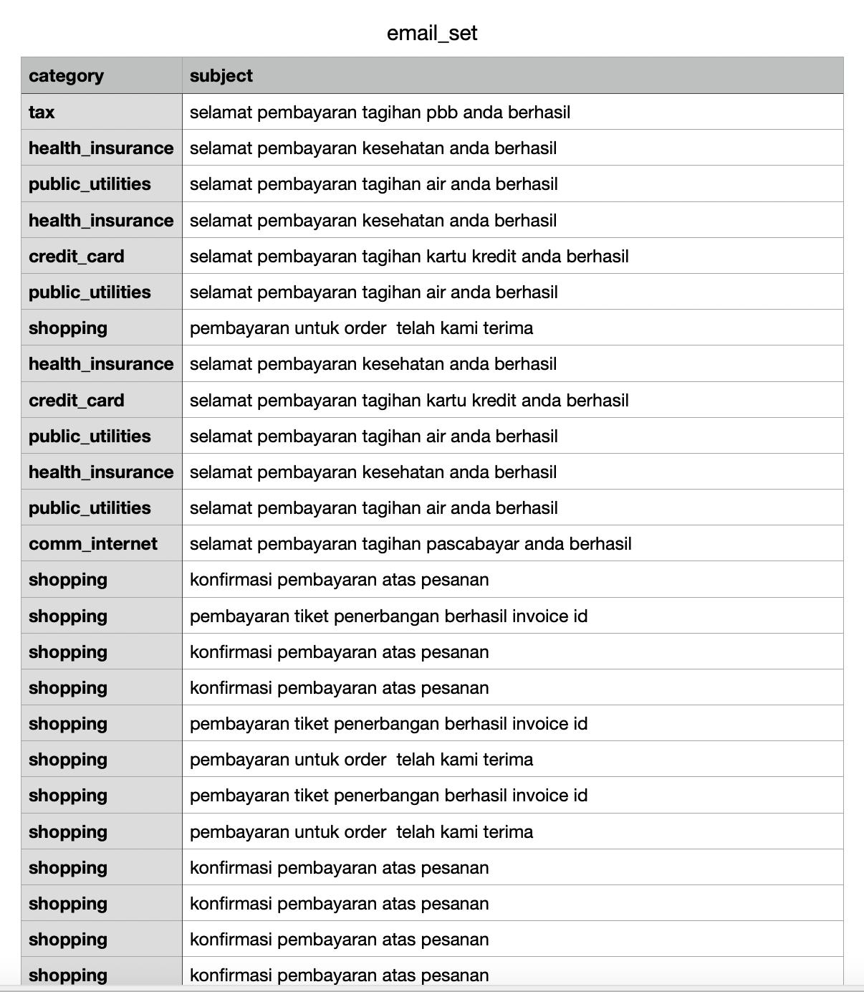
Implementation
Data Extraction
Tax : 2 number of rows
Health_insurance : 5 number of rows
Public_utilities : 4 number of rows
Credit_card : 3 number of rows
Shopping : 112 number of rows
Comm_internet : 26 number of rows
Loan : 37 number of rows

Slide 11
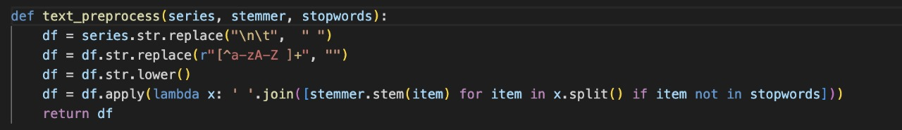
Implementation
Data Pre-process
Pre-processing using Sastrawi Library

Slide 12
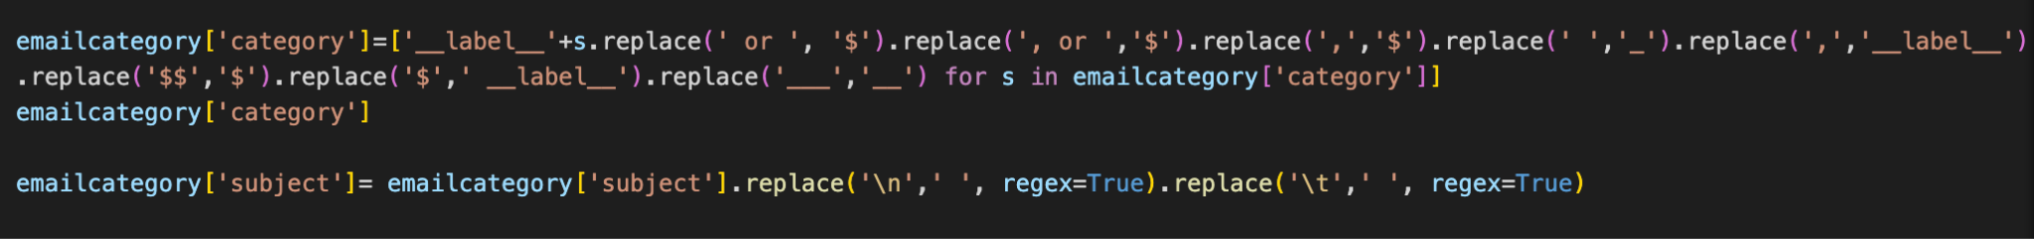
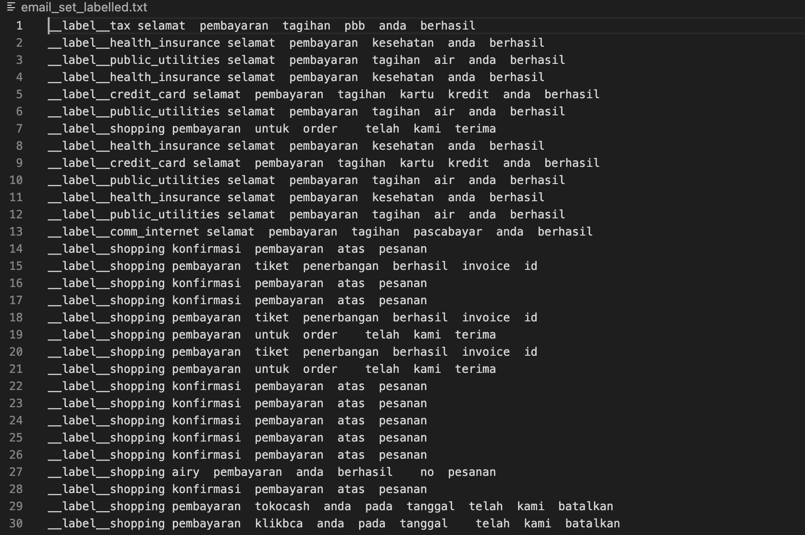
Implementation
Data Pre-process
Manually labeled email set
Labeled email set

Slide 13
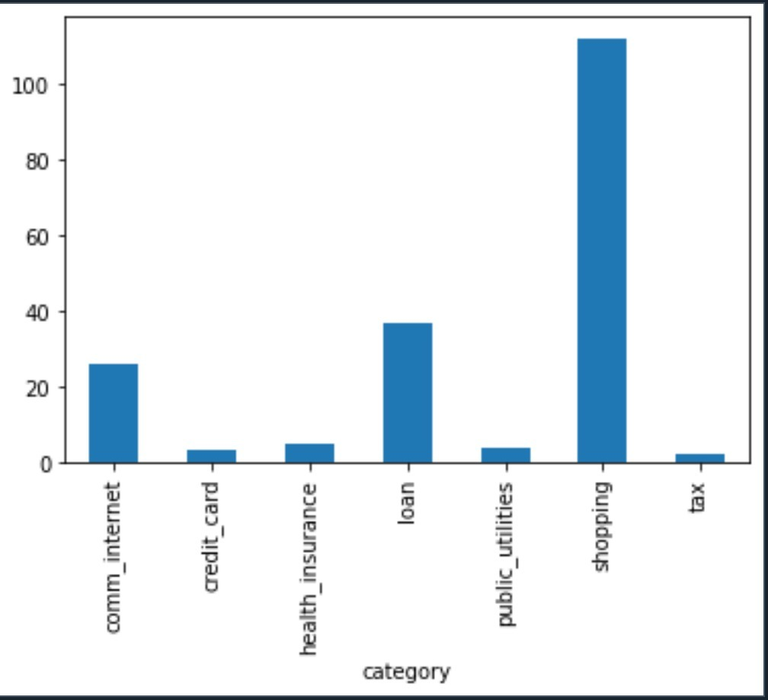
Implementation
Data Training and Set
During coding and implementation, it becomes a challenge when training a data set using a specific word. This research applies the manual labeling into the data set and then being trained by supervised learning using the fastText library. Using epoch =25,lr=1.0, and wordNgrams=1 classifications. Below is the distribution of the dataset to the manual labeling.

Slide 14
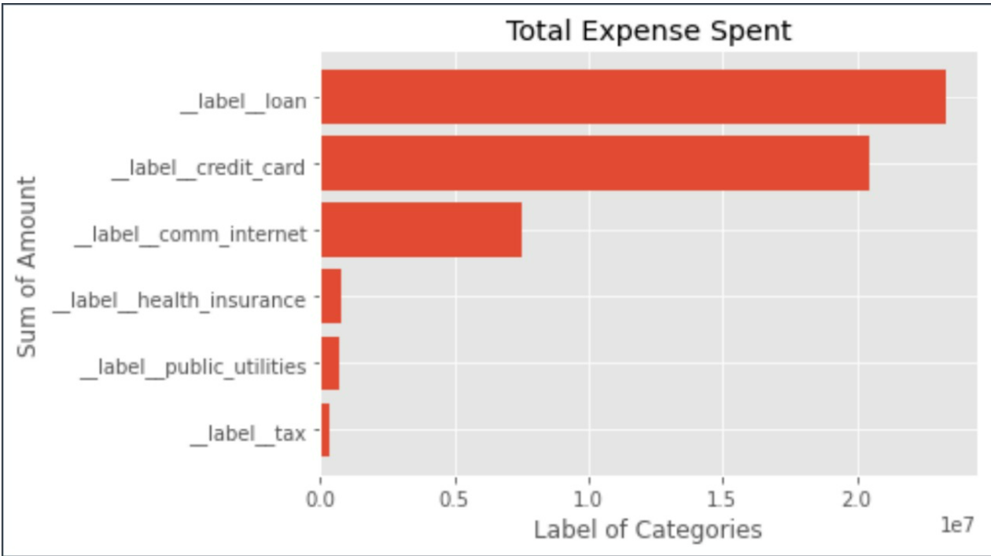
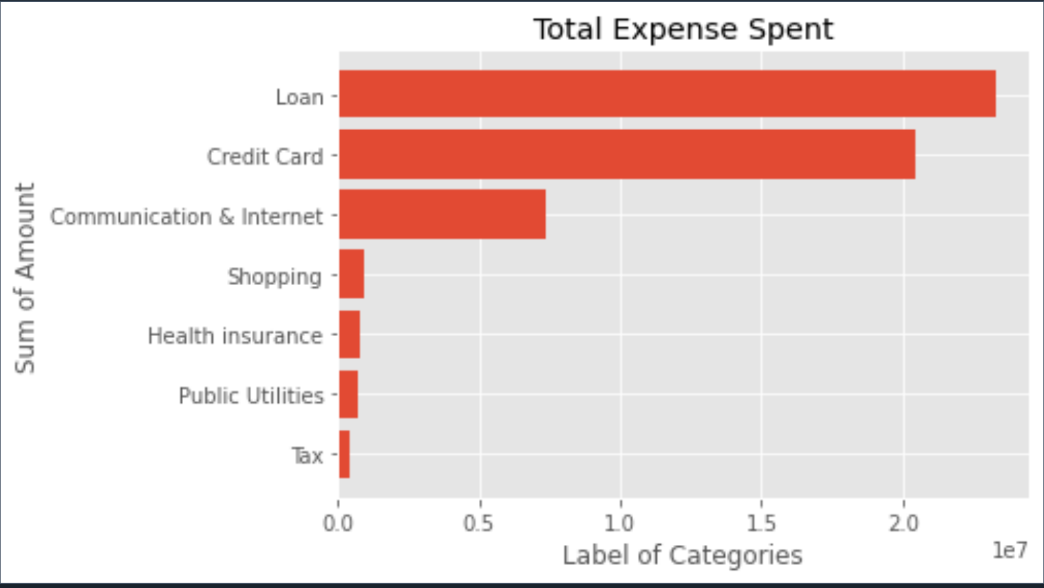
Implementation
Data Transformation
Fig Machine Learning Modeling Classification Result
Fig. Manual Modeling Classification Result

Slide 15
Evaluation Model
Overall accuracy percentage is 85.71%, calculated with the ML model result / Manual model labeling. Only the label Shopping is not being predicted during the process.

Slide 16
Conclusion
The classification method is quite accurate to categorize the expenses from the GMAIL mailbox.
For future research, data pre-processing steps should produce a clean data set.

